Slide 1

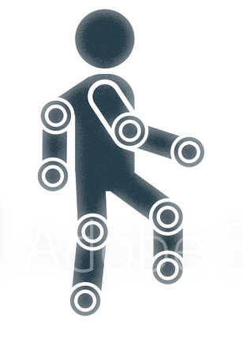
Task – Project A15
Group – 15
Nikhil Jagtap Kapil Deshmukh Uzair Mukadam Aditya Bhat Akshay Panchwagh

Slide 2
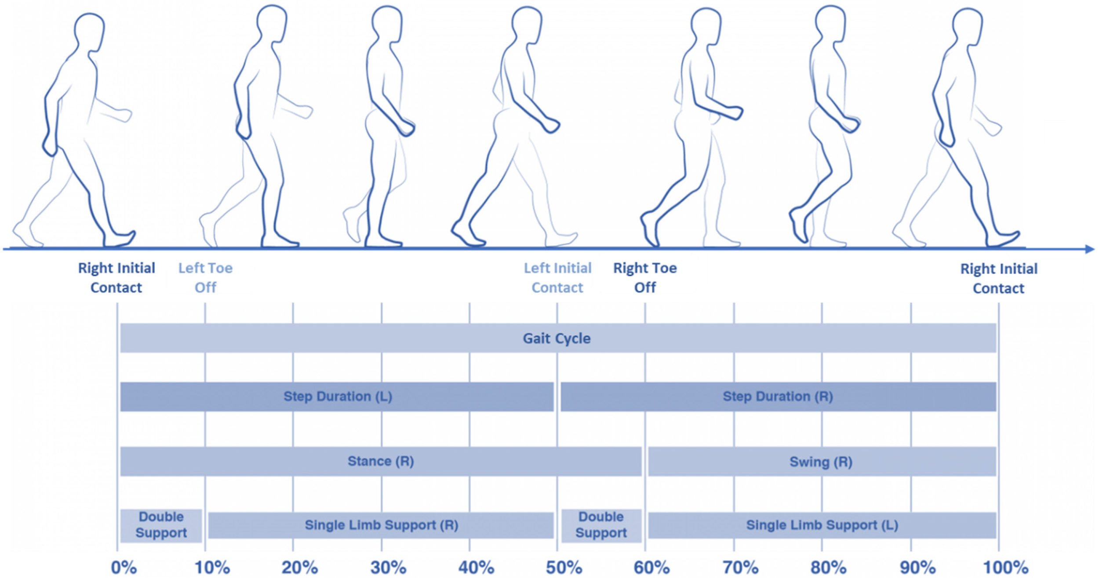
Agenda
Team Introduction
Gait Analysis
Data Preprocessing
Implementation of Neural Network
Further Improvements

Slide 3
Team Worked on 2, 5 & 10 Fold Subject wise CV
The Group was assigned with the task of utilizing the data from Smartphone 3 from the accelerometer & gyroscope to perform 2, 5 and 10 fold subject-wise cross-validations in-order to train the system to distinguish between the impaired and normal gait patterns.
Nikhil Jagtap – Research & Comprehensive Primary Coding
Akshay Panchwagh – Research & Data Procurement
Kapil Deshmukh – Research & Neural Network Coding
Aditya Bhat – Research & Secondary Coding
Uzair Mukadam – Research & Presentation Draft

Slide 4
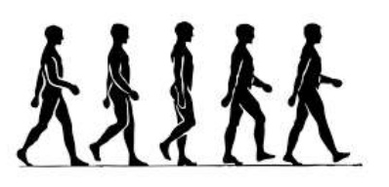
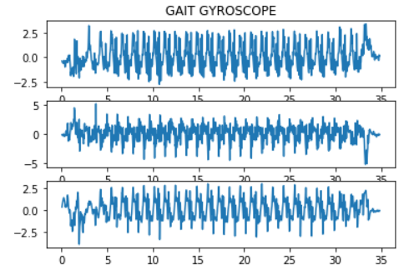
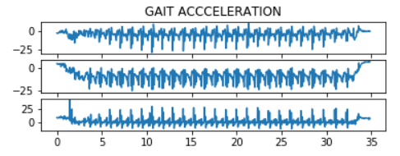
Gait Analysis
Gait is the special pattern of human locomotion & is unique to an individual due to one's specific musculoskeletal bio-mechanism.
The movement data was measured via inertial sensors to plot the acceleration and gyroscope data (Phyphox application was used to measure data).

Slide 5

Data Preprocessing
Find start point in measurements
Data Collection
Data Analysis
Signal Filtration
Extract Motion Sequence
Filter Noise
Segmentation & Resampling
Label Data
Implementation of Neural Network

Slide 6
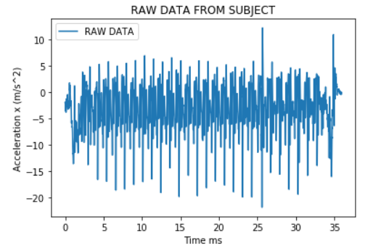
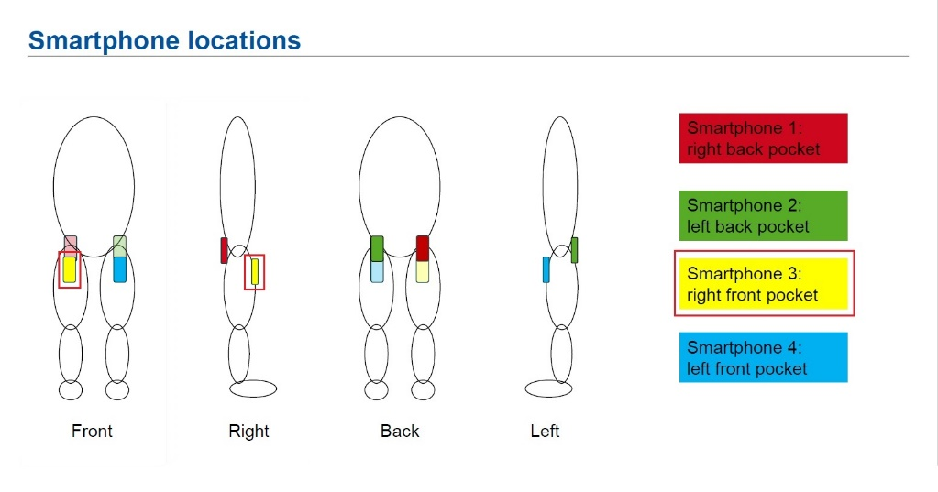
Data Collection
Phyphox used to collect data in CSV format for gait analysis.
Data collected for all Subjects with Position- Smartphone 3 (Right Front pocket)

Slide 7
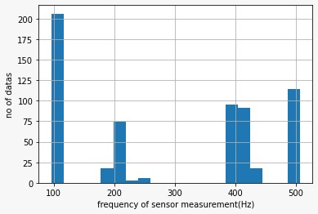
Data Analysis
Individual frequency of sensors was determined.
Furthermore, histogram was plotted for the No. of Subjects VS Frequency of
Sensor to establish the frequency mode for better understanding of the data.

Slide 8
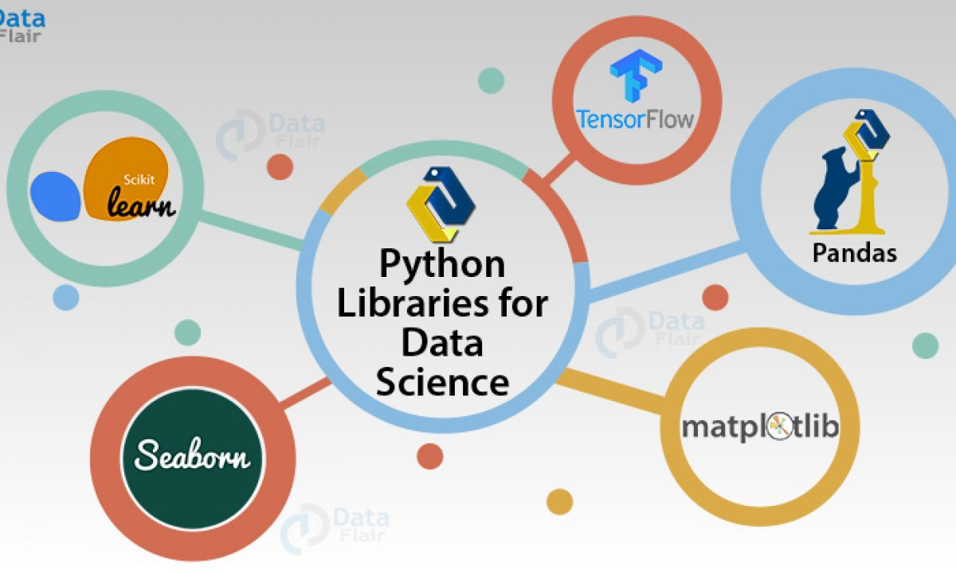
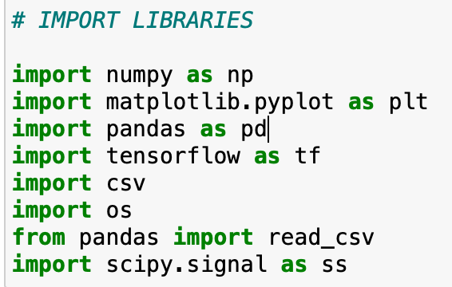
Libraries Used
numpy
matplotlib.pyplot
pandas
tensorflow
csv
os
scipy.signal

Slide 9
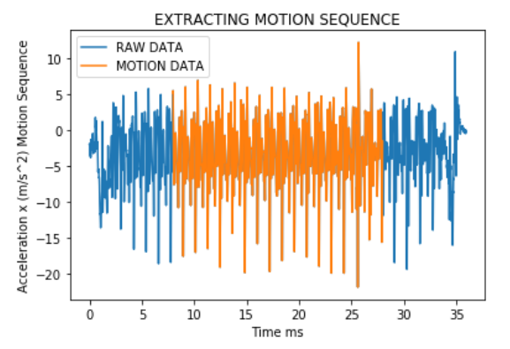
Extraction of Motion Sequence
Data was extracted from the mean value of the time domain for both Accelerometer and Gyroscope of each subject.

Slide 10
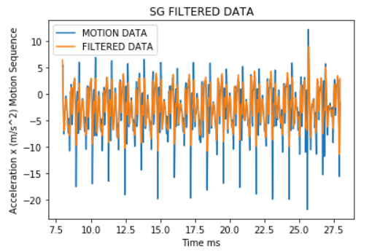
Filtering Noise
Filters significant for Gait Analysis are:
1.) Butterworth
2.) Infinite Impulse Response (IIR)
3.) Savitzky-Golay (SG)
SG filter was chosen as it retains the original shape of the signal.

Slide 11
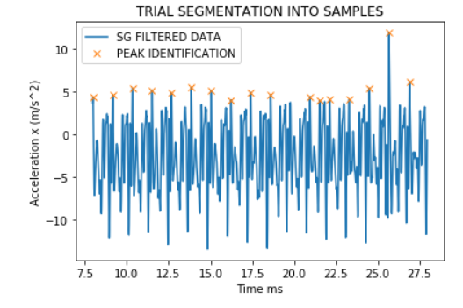
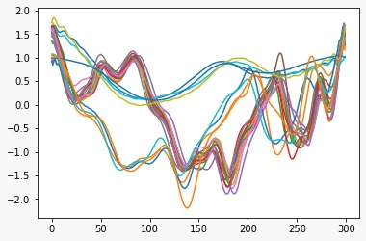
Trial Segmentation into Samples & Resampling
Acceleration x (m/s^2)
Time (ms)
Identification of peaks using local maxima method via “peaks” function from the “scipy” library

Slide 12
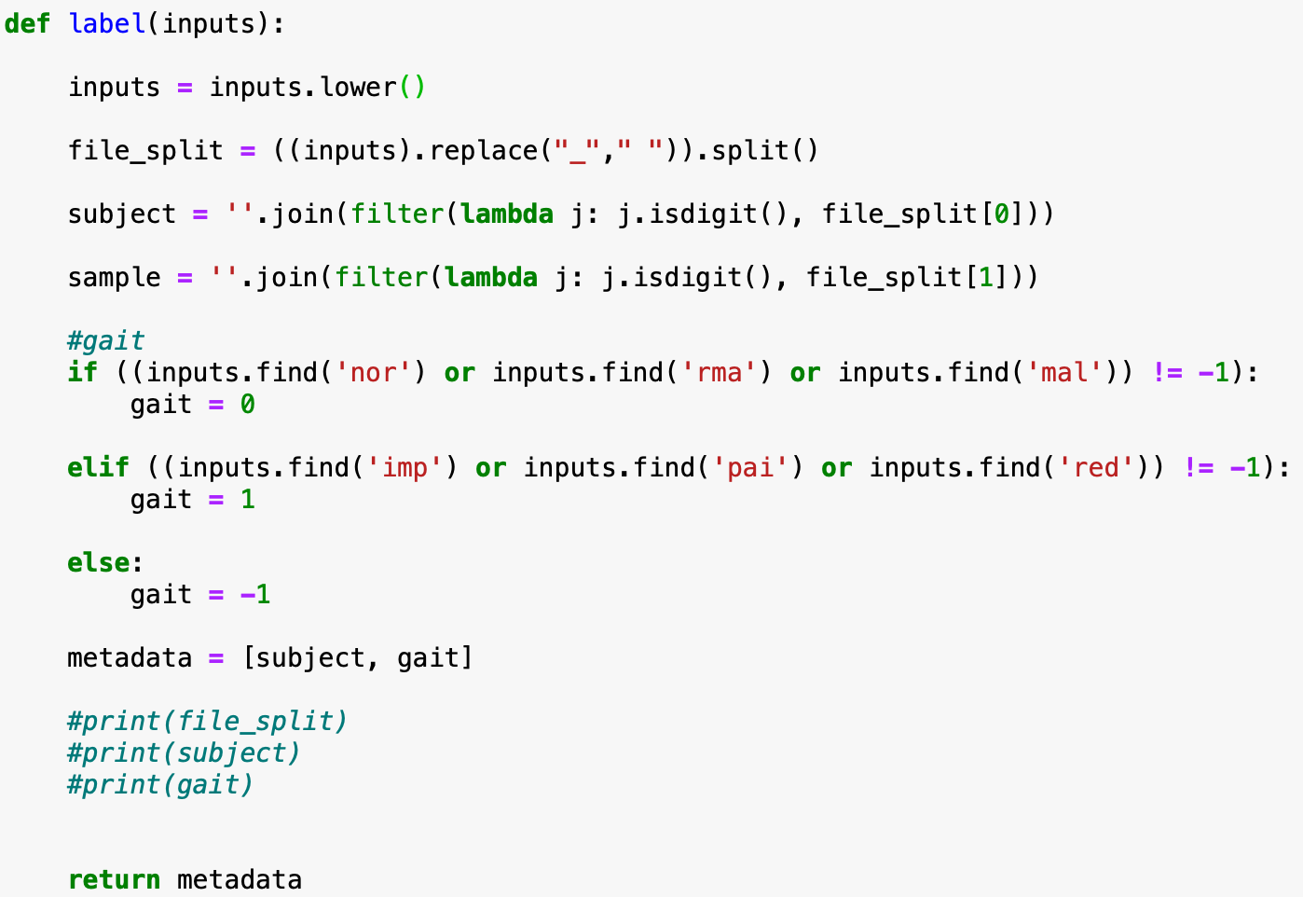
Data Labelling
eg. inputs=Subject25_normal01
inputs=subject25_normal01
file_split=['subject25', 'normal01']
subject=25
sample=01
gait =0 (normal subject)
Metadata = [‘25’,0]

Slide 13
Implementation of Neural Network
Split Data (Cross-Validation)
Hyper Parameter of Neural Network
Comparing Accuracy Results

Slide 14
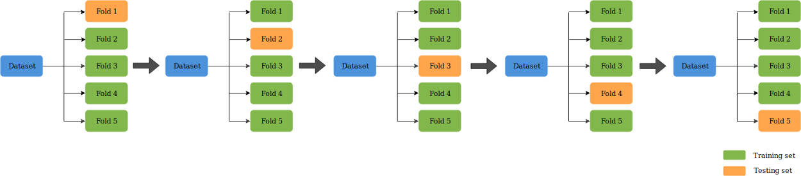
Split Data (Cross-Validation)
Cross validation is a resampling procedure used to evaluate machine learning models on a limited data sample.
The procedure has a single parameter called ‘k’ which refers to the number of groups the given data sample will be split into.
In this task, the data sample was split into 2,5 and 10 folds.

Slide 15
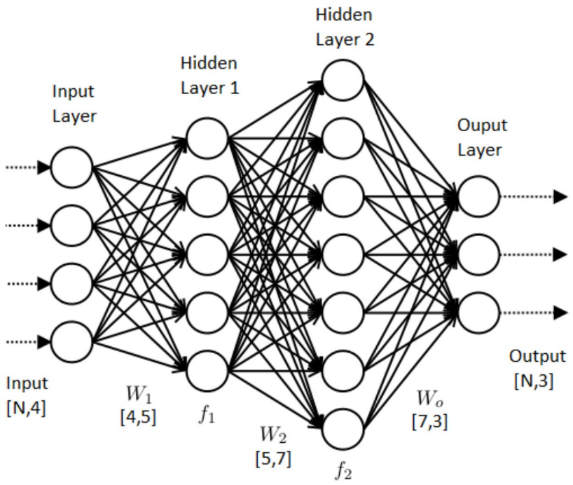
Hyper Parameter of Neural Network
Parameters used:
Loss function : Mean Square Error
Optimizer : Adam
Activation Function : Relu, SoftMax
No. of Epochs: 10
Batch Size: 20
Input Layer: 6 Neurons in the Input
Hidden Layer: 5
General Representation of Neural Network [1]
*Image only for representation
[1] https://medium.com/coinmonks/the-artificial-neural-networks-handbook-part-1-f9ceb0e376b4

Slide 16
Comparing Results
No. of Folds | 2 | 5 | 10
Loss | 0.2500 | 0.2500 | 0.2500
Accuracy | 0.50515 | 0.50375 | 0.4723

Slide 17
Further Improvements
Data Rotation
Removing Outliers
Fine Tuning the Neural Network

Slide 18
References
https://medium.com/towards-artificial-intelligence/importance-of-k-fold-cross-validation-in-machine-learning-a0d76f49493e
https://machinelearningmastery.com/k-fold-cross-validation/#:~:text=Cross%2Dvalidation%20is%20a%20resampling,is%20to%20be%20split%20into.
https://pythonprogramming.net/resample-data-analysis-python-pandas-tutorial/
https://www.researchgate.net/publication/322796242_Advanced_Methods_for_Gait_Analysis_Data_Processing
https://dl.acm.org/doi/10.1145/1921081.1921099
https://machinelearningmastery.com/how-to-model-human-activity-from-smartphone-data/
https://www.python-course.eu/principal_component_analysis.php
https://www.kaggle.com/hbaderts/simple-feed-forward-neural-network-with-tensorflow
https://hub.packtpub.com/feedforward-networks-tensorflow/
https://stackabuse.com/tensorflow-neural-network-tutorial/
https://docs.scipy.org/doc/scipy/reference/generated/scipy.signal.resample.html
https://pandas.pydata.org/pandas-docs/stable/reference/api/pandas.Series.interpolate.html
https://scipy-lectures.org/intro/scipy/auto_examples/plot_resample.html
https://towardsdatascience.com/human-activity-recognition-har-tutorial-with-keras-and-core-ml-part-1-8c05e365dfa0
https://statinfer.com/204-4-11-k-fold-cross-validation/
https://www.machinecurve.com/index.php/2020/02/18/how-to-use-k-fold-cross-validation-with-keras/
https://towardsdatascience.com/pca-using-python-scikit-learn-e653f8989e60
https://www.geeksforgeeks.org/ml-principal-component-analysispca/
https://stackabuse.com/implementing-pca-in-python-with-scikit-learn/
https://towardsdatascience.com/reshaping-numpy-arrays-in-python-a-step-by-step-pictorial-tutorial-aed5f471cf0b
https://www.geeksforgeeks.org/multi-dimensional-lists-in-python/
https://stackoverflow.com/questions/51505504/pandas-nesting-dataframes

Slide 19
References
Markus Lueken, Warner ten Kate (2019), IEEE, “Peak Detection Algorithm for Gait Segmentation in Long-Term Monitoring for Stride Time Estimation Using Inertial Measurement Sensors”
Manuela Galli and Mariano Serrao (2018), Springer Int. Publishing, “Advanced Methods for Gait Analysis Data Processing”
Nooshin Haji Ghassemi, Julius Hannink (2018), MDPI Sensors, “Segmentation of Gait Sequences in Sensor-Based Movement Analysis: A Comparison of Methods in Parkinson’s Disease”
Faisal Jamil, Naeem Iqbal (2020), MDPI Sensors, “Toward Accurate Position Estimation Using Learning to Prediction Algorithm in Indoor Navigation”
Yu Zhong and Yunbin Deng (2014), IJCB, “Sensor Orientation Invariant MObile Gait Biometrics”

